Slide 1

Terrorism Response and Disaster Management
CHAPTER 41

Slide 2
National EMS Education Standard Competencies (1 of 2)
EMS Operations
Knowledge of operational roles and responsibilities to ensure patient, public, and personnel safety.
Notes:
National EMS Education Standard Competencies
EMS Operations
Knowledge of operational roles and responsibilities to ensure patient, public, and personnel safety.

Slide 3
National EMS Education Standard Competencies (2 of 2)
Mass-Casualty Incidents Due to Terrorism and Disaster
Risks and responsibilities of operating on the scene of a natural or man-made disaster
Notes:
National EMS Education Standard Competencies
Mass-Casualty Incidents Due to Terrorism and Disaster
• Risks and responsibilities of operating on the scene of a natural or man-made disaster.

Slide 4
Introduction
You may be called on to respond to a terrorist event during your career.
It is difficult to plan for and anticipate a response to many terrorist events.
  Several key principles apply to every response.
Notes:
Lecture Outline
I. Introduction
It is possible that you may be called on to respond to a terrorist event during your career.
1. The question is not will terrorists strike again, but rather when and where they will strike.
2. You must be mentally and physically prepared for the possibility of a terrorist event.
B. It is difficult to plan and anticipate a response to many terrorist events, yet there are several key principles that apply to every response.

Slide 5
What Is Terrorism? (1 of 4)
Terrorist forces have been at work since early civilizations.
Terrorism involves violent acts or acts dangerous to human life that violate federal or state law and appears to be intended to:
  Intimidate or coerce a civilian population
  Influence the policy of a government by intimidation or coercion
  Affect the conduct of a government by mass destruction, assassination, or kidnapping
Notes:
Lecture Outline
II. What Is Terrorism?
A. Terrorist forces have been at work since early civilizations.
1. The US Department of Justice defines both international terrorism and domestic terrorism with these points:
a. Involves violent acts or acts dangerous to human life that violate federal or state law
b. Appears to be intended (i) to intimidate or coerce a civilian population; (ii) to influence the policy of a government by intimidation or coercion; or (iii) to affect the conduct of a government by mass destruction, assassination, or kidnapping

Slide 6
What Is Terrorism? (2 of 4)
International terrorism occurs primarily outside of the United States.
Domestic terrorism occurs primarily within the United States.
Only a small percentage of groups actually turn to terrorism to achieve their goals.
Notes:
Lecture Outline
2. One difference between the two is location.
a. International terrorism occurs primarily outside the territorial jurisdiction of the United States.
b. Domestic terrorism occurs primarily within the territorial jurisdiction of the United States.
3. Modern-day terrorism is common in the Middle East where terrorist groups frequently attacked civilian populations.
4. In the United States, domestic terrorists have carried out multiple attacks.
B. Only a small percentage of groups actually turn toward terrorism as a means to achieve their goals.

Slide 7
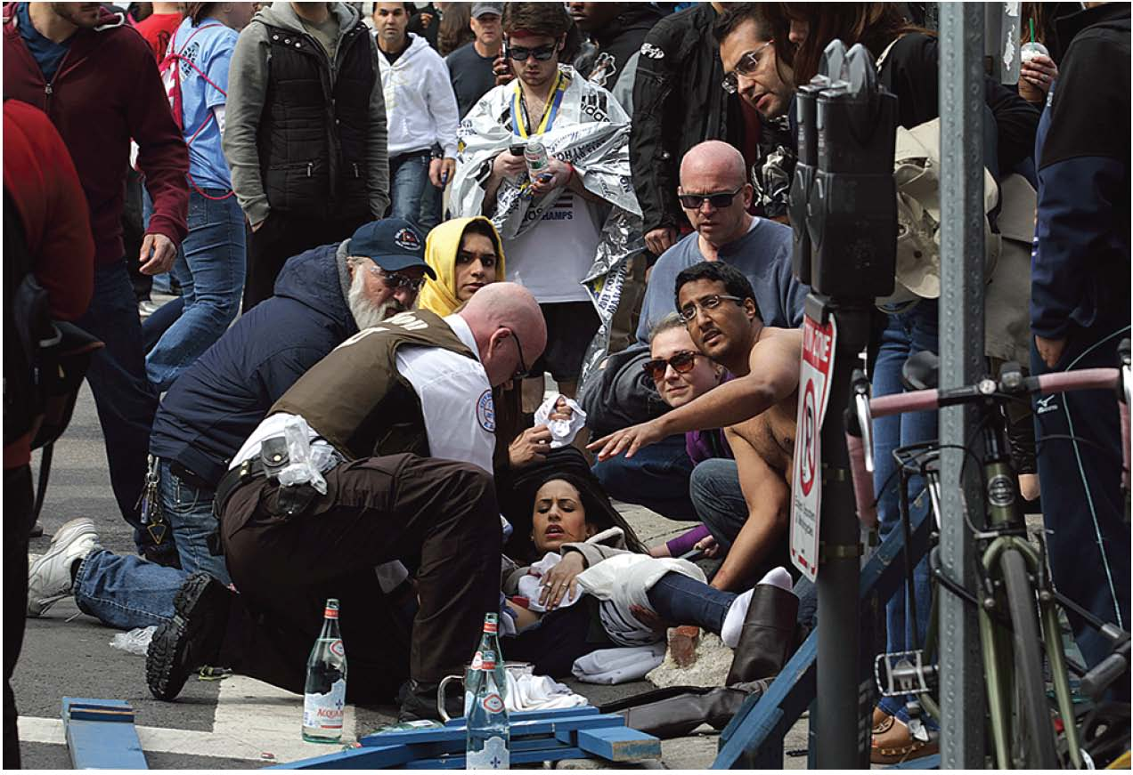
What Is Terrorism? (3 of 4)
Religious extremist groups/doomsday cults
  May participate in apocalyptic violence
Extremist political groups
  Seek political, religious, economic, and social freedom
FIGURE 41-1 The bombing at the Boston Marathon in 2013 was an example of domestic terrorism.
© Bill Greene/The Boston Globe/Getty Images.
Notes:
Lecture Outline
1. Religious extremist groups/doomsday cults
2. Extremist political groups
a. Include violent separatist groups and those who seek political, religious, economic, and social freedom

Slide 8
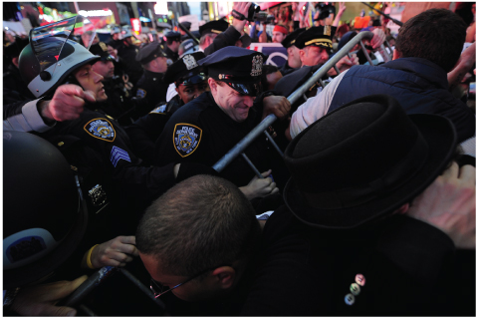
What Is Terrorism? (4 of 4)
Cyber terrorists
  Attack a population’s technological infrastructure
Single-issue groups
  Include antiabortion groups, animal rights groups, anarchists, racists, ecoterrorists
FIGURE 41-2 Demonstrators being held back by police in Times Square in 2011.
© EMMANUEL DUNAND/AFP/Getty Images.
Notes:
Lecture Outline
3. Cyber terrorists
4. Single-issue groups

Slide 9
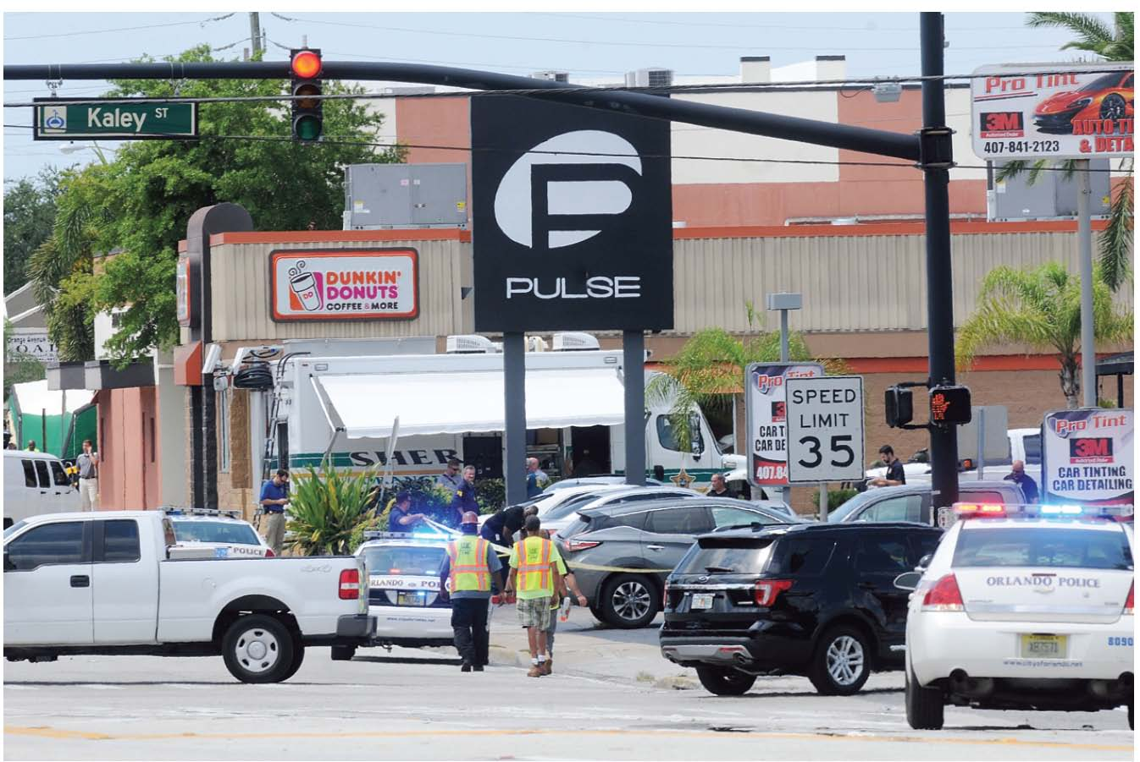
Active Shooter Events (1 of 4)
“Lone wolf” terrorist attack
Frequent threat in the United States
Motives of the attacker are not always clear.
Attacks may target
  Schools
  Music festivals
  Shopping centers
FIGURE 41-3 The Pulse nightclub shooting in Orlando in 2016 was an example of a lone wolf terrorist attack.
The Pulse nightclub shooting in Orlando in 2016 was an example of a lone wolf terrorist attack.
Notes:
III. Active Shooter Events
A. An alarming new trend in domestic terrorism involves the concept of the lone wolf terrorist attack.
1. This has become a frequent threat in the United States.
2. The National Security Critical Issue Task Force defines lone wolf terrorism as “the deliberate creation and exploitation of fear through violence or threat of violence by a single actor who pursues political change linked to a formulated ideology, whether his own or that of a larger organization, and who does not receive orders, direction, or material support from outside sources.”
3. The motives of the lone wolf terrorist are not always clear.
a. Attacks may target schools, music festivals, or shopping centers and are difficult to predict.

Slide 10
Active Shooter Events (2 of 4)
Many lone wolf terrorist attacks involve firearms rather than explosives.
This has prompted discussion of:
  Gun laws
  Mental health
  Education of the public and first responders on how to treat casualties
Notes:
B. Many lone wolf terrorist attacks involve firearms and not explosives.
1. This type of event is classified as an active shooter event.
2. These attacks have prompted discussion of gun laws, mental health, and education of the public and first responders on how to treat the casualties of active shooter events.

Slide 11
Active Shooter Events (3 of 4)
Hartford Consensus recommends using the acronym THREAT:
  Threat suppression
  Hemorrhage control
  Rapid extrication to safety
  Assessment by medical providers
  Transport to definitive care
Notes:
a. The Hartford Consensus recommends that a response plan for active shooter response should include the acronym THREAT: Threat suppression, hemorrhage control, rapid extrication to safety, assessment by medical providers, and transport to definitive care.

Slide 12
Active Shooter Events (4 of 4)
EMS crews may be equipped with ballistic vests and helmets.
May be paired with law enforcement to assist with the treatment and evacuation of injured people form an active scene
Interagency training is a key component.
Notes:
b. EMS crews may be equipped with ballistic vests and helmets so they can potentially be paired with law enforcement to assist with treatment and evacuation of injured people from an active scene.
i. A key component to safely incorporating EMS crews with law enforcement teams who are moving forward into an active shooter scene is interagency training.

Slide 13
Weapons of Mass Destruction (1 of 6)
Also called weapons of mass casualty
Any agent designed to bring about:
  Mass death
  Casualties
  Massive damage to property and infrastructure
Notes:
Lecture Outline
IV. Weapons of Mass Destruction
A. A weapon of mass destruction (WMD), or weapon of mass casualty (WMC), is any agent designed to bring about:
1. Mass death
2. Casualties
3. Massive damage to property and infrastructure (bridges, tunnels, airports, and seaports)

Slide 14
Weapons of Mass Destruction (2 of 6)
B-NICE and CBRNE are mnemonics for the kinds of WMDs.
B-NICE
  Biologic
  Nuclear
  Incendiary
  Chemical
  Explosive
Notes:
Lecture Outline
B. B-NICE and CBRNE are mnemonics to remember the kinds of weapons of mass destruction.
1. B-NICE
a. Biologic
b. Nuclear
c. Incendiary
d. Chemical
e. Explosive

Slide 15
Weapons of Mass Destruction (3 of 6)
CBRNE
  Chemical
  Biologic
  Radiologic
  Nuclear
  Explosive
Notes:
Lecture Outline
2. CBRNE
a. Chemical
b. Biologic
c. Radiologic
d. Nuclear
e. Explosive

Slide 16
Weapons of Mass Destruction (4 of 6)
Explosives have been the preferred WMD.
Chemical agents consist of:
  Vesicants (blister agents)
  Respiratory agents (choking agents)
  Nerve agents
  Metabolic agents (cyanides)
Notes:
Lecture Outline
C. To date, the preferred WMD for terrorists has been explosive devices.
1. WMDs are relatively easy to obtain or create and are specifically geared toward killing large numbers of people.
D. Chemical terrorism/warfare
1. Chemical agents are manufactured substances that can have devastating effects on living organisms.
2. They can be produced in liquid, powder, or vapor form, depending on the desired route of exposure and dissemination technique.
3. These agents consist of the following types:
a. Vesicants (blister agents)
b. Respiratory agents (choking agents)
c. Nerve agents
d. Metabolic agents (cyanides)

Slide 17
Weapons of Mass Destruction (5 of 6)
Biologic terrorism/warfare
  Biologic agents are organisms that cause disease.
  The primary types are:
    Viruses
    Bacteria
    Toxins
Notes:
Lecture Outline
E. Biologic terrorism/warfare
1. Biologic agents are organisms that cause disease.
2. Generally found in nature; for terrorist use, however, they are cultivated, synthesized, and mutated in a laboratory.
3. Weaponization of biologic agents is performed to artificially maximize the target population’s exposure to the germ.
4. The primary types are:
a. Viruses
b. Bacteria
c. Toxins

Slide 18
Weapons of Mass Destruction (6 of 6)
Nuclear/radiologic terrorism
  Only two publicly known incidents: Hiroshima and Nagasaki
  These materials are far easier for a determined terrorist to acquire and require less expertise to use.
  “Dirty bombs” can cause widespread panic.
Notes:
Lecture Outline
F. Nuclear/radiologic terrorism
1. There have been only two publicly known incidents involving the use of a nuclear device.
a. Hiroshima and Nagasaki
2. It is possible for a terrorist to secure radioactive materials or waste to perpetrate an act of terror.
a. These materials are far easier for a determined terrorist to acquire and require less expertise to use.
b. “Dirty bombs” can cause widespread panic and civil disturbances.

Slide 19
EMT Response to Terrorism (1 of 3)
The basic foundations of patient care remain the same.
  Treatment can and will vary.
  Always remember situational awareness.
Recognizing a terrorist event
  Planning of acts of terror is covert.
  You must know the current threat level issued by the Department of Homeland Security (DHS).
Notes:
Lecture Outline
V. EMT Response to Terrorism
A. The basic foundations of patient care remain the same.
1. The treatment can and will vary.
2. Always remember situational awareness.
B. Recognizing a terrorist event (indicators)
1. The planning of most acts of terror is covert, which means that the public safety community generally has no prior knowledge of the time, location, or nature of the attack.
a. You must constantly be aware of your surroundings and understand the possible risks for terrorism.
b. You must know the current threat level issued by the federal government through the Department of Homeland Security (DHS).

Slide 20
EMT Response to Terrorism (2 of 3)
National Terrorism Advisory System (NTAS)
  Alerts from the NTAS contain a summary of the threat and the actions that first responders, government agencies, and the public can take to maintain safety.
Notes:
Lecture Outline
2. In April 2011, the color-coded Homeland Security Advisory System was replaced by the National Terrorism Advisory System (NTAS).
a. Alerts from the NTAS contain a summary of the threat and the actions that first responders, government agencies, and the public can take to maintain safety.

Slide 21
EMT Response to Terrorism (3 of 3)
On every call, you must make the following observations:
  Type of location
  Type of call
  Number of patients
  Victims’ statements
  Preincident indicators
Notes:
Lecture Outline
3. Make sure you are aware of information sent out by the advisory system at the start of your workday.
4. On every call, make the following observations:
a. Type of location
b. Type of call
c. Number of patients
d. Victims’ statements
e. Preincident indicators

Slide 22
Response Actions (1 of 6)
Scene safety
  Stage your vehicle a safe distance away.
  Wait for law enforcement personnel.
  If you have any doubt, do not enter.
  The best location for staging is upwind and uphill from the incident.
Secondary device
  Additional explosives set to explode after the initial bomb
Notes:
Lecture Outline
C. Response actions
1. Scene safety
a. Remember to stage your vehicle a safe distance from the incident.
b. Wait for law enforcement personnel to advise you that the scene has been made secure.
c. If you have any doubt that it may not be safe, do not enter.
d. The best location for staging is upwind and uphill from the incident.
e. Remember the following rules:
i. Failure to park your vehicle at a safe location can place you and your partner in danger.
ii. If your vehicle is blocked in by other emergency vehicles or damaged by a secondary device (or event), you will be unable to provide victims with transportation or escape yourself.
f. Secondary device
i. Additional explosives that are set to explode after the initial bomb.
ii. Intended primarily to injure responders and to secure media coverage.
iii. May include various types of electronic equipment such as cell phones or pagers.

Slide 23
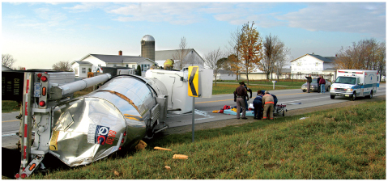
Response Actions (2 of 6)
FIGURE 41-6 Park your vehicle at a safe location.
© Dennis MacDonald/Alamy.
Notes:
The figure on this slide show an example of safely staging an ambulance.

Slide 24
Response Actions (3 of 6)
Responder safety
  The best form of protection is preventing yourself from coming in contact with the agent.
  Contamination occurs when you have direct contact with the WMD.
  Cross-contamination occurs when you come in contact with a contaminated person.
Notes:
Lecture Outline
Responder safety (personnel protection)
a. The best form of protection from a WMD agent is preventing yourself from coming into contact with the agent.
b. The greatest threats are contamination and cross-contamination.

Slide 25
Response Actions (4 of 6)
Notification procedures
  Notify the dispatcher of:
    The nature of the event
    Any additional resources that may be required
    The estimated number of patients
    The upwind or optimal route of approach
  Establish a staging area.
  Trained responders in PPE are the only persons equipped to handle the WMD incident.
Notes:
Lecture Outline
3. Notification procedures
a. Notify the dispatcher when you suspect a terrorist or WMD.
b. Inform dispatch of:
i. The nature of the event
ii. Any additional resources that may be required
iii. The estimated number of patients
iv. The upwind route of approach or optimal route of approach
c. It is extremely important to establish a staging area, where other units will converge.
d. Trained responders in the proper protective equipment are the only persons equipped to handle the WMD incident.
e. Keep in mind that there may be more than one type of device or agent present.

Slide 26
Response Actions (5 of 6)
Establishing command
  You may need to establish command until additional personnel arrive.
  You and other EMTs may function as:
    Medical branch directors
    Triage, treatment, or transportation supervisors
    Logistics officers
    Command and general staff
Notes:
Lecture Outline
4. Establishing command
a. As the first provider on scene, the EMT may need to establish command until additional personnel arrive.
b. You and other EMTs may function as:
i. Medical branch directors
ii. Triage supervisors
iii. Treatment supervisors
iv. Transportation supervisors
v. Logistic officers
vi. Command and general staff
c. If the initial incident command system (ICS) is already in place, immediately seek out the medical staging officer to receive your assignment.

Slide 27
Response Actions (6 of 6)
Reassessing scene safety
  Constantly assess and reassess the scene for safety.
  This is an important component of situational awareness.
Notes:
Lecture Outline
5. Reassessing scene safety
a. Constantly assess and reassess the scene for safety.
b. Important component of situational awareness.

Slide 28
Chemical Agents (1 of 2)
Liquids or gases that are dispersed to kill or injure
  Persistent (nonvolatile) agents can remain on a surface for long periods.
  Nonpersistent (volatile) agents evaporate rapidly.
Notes:
Lecture Outline
VI. Chemical Agents
A. Liquids or gases that are dispersed to kill or injure.
1. The characteristics of an agent can be described as liquid, gas, or solid material.
2. Persistent or nonvolatile agents can remain on a surface for long periods, usually longer than 24 hours.
3. Nonpersistent or volatile agents evaporate rapidly when left on a surface in the optimal temperature range.

Slide 29
Chemical Agents (2 of 2)
Route of exposure is how the agent most effectively enters the body.
  Agents with a vapor hazard enter through the respiratory tract in the form of vapors.
  Agents with a contact hazard (or skin hazard) give off very little vapor or no vapors and enter the body through the skin.
Notes:
Lecture Outline
4. Route of exposure is how the agent most effectively enters the body.
a. Agents with a vapor hazard enter the body through the respiratory tract in the form of vapors.
b. Agents with a contact hazard (or skin hazard) give off very little vapor or no vapors and enter the body through the skin.

Slide 30
Vesicants (1 of 5)
Primary route is the skin (contact).
  If vesicants are left on the skin long enough, they produce vapors that can enter the respiratory tract.
Cause burnlike blisters to form on the victim’s skin and in the respiratory tract
Usually cause the most damage to damp or moist areas of the body
Notes:
Lecture Outline
B. Vesicants (blister agents)
1. The primary route of exposure of blister agents, or vesicants, is the skin (contact).
2. However, if vesicants are left on the skin or clothing long enough, they produce vapors that can enter the respiratory tract.
3. Cause burnlike blisters to form on the victim’s skin and in the respiratory tract.
4. The vesicant agents consist of:
a. Sulfur mustard (H)
b. Lewisite (L)
c. Phosgene oxime (CX)
5. The vesicants usually cause the most damage to damp or moist areas of the body, such as the armpits, groin, and respiratory tract.

Slide 31
Vesicants (2 of 5)
Signs of vesicant exposure on the skin:
  Skin irritation, burning, and reddening
  Immediate, intense skin pain
  Formation of large blisters
  Gray discoloration of skin
  Swollen and closed or irritated eyes
  Permanent eye injury (including blindness)
Notes:
Lecture Outline
6. Signs of vesicant exposure on the skin include the following:
a. Skin irritation, burning, and reddening
b. Immediate, intense skin pain
c. Formation of large blisters
d. Gray discoloration of skin
e. Swollen and closed or irritated eyes
f. Permanent eye injury (including blindness)
7. Signs and symptoms if vapors were inhaled
a. Hoarseness and stridor
b. Severe cough
c. Hemoptysis
d. Severe dyspnea

Slide 32
Vesicants (3 of 5)
Sulfur mustard (H)
  Brown-yellow oily substance
  Generally considered very persistent
  Begins an irreversible process of damage to the cells
  Attacks vulnerable cells within the bone marrow and depletes the body’s ability to reproduce white blood cells
  Sulfur mustard vapors can be inhaled, creating upper and lower airway compromise.
Notes:
Lecture Outline
Sulfur mustard (H) is a brown-yellow oily substance that is generally considered very persistent.
a. As the agent is absorbed into the skin, it begins an irreversible process of damage to the cells.
b. Mustard is considered a mutagen, which means that it mutates, damages, and changes the structures of cells.
c. The patient will experience a progressive reddening of the affected area, which will gradually develop into large blisters.
d. Mustard also attacks vulnerable cells within the bone marrow and depletes the body’s ability to reproduce white blood cells.
e. Sulfur mustard vapors can be inhaled, creating upper and lower airway compromise.

Slide 33
Vesicants (4 of 5)
Lewisite (L) and phosgene oxime (CX)
  Produce blister wounds very similar to those caused by mustard
  Produce immediate intense pain and discomfort when contact is made
  The patient may have a gray discoloration at the contaminated site.
Notes:
Lecture Outline
9. Lewisite and phosgene oxime produce blister wounds very similar to those caused by mustard.
a. Produce immediate intense pain and discomfort when contact is made.
b. The patient may have a gray discoloration at the contaminated site.

Slide 34
Vesicants (5 of 5)
Vesicant agent treatment
  No antidotes for mustard or CX exposure
  Ensure that the patient has been decontaminated before treatment is initiated.
  If agent has been inhaled, the patient may require prompt airway support.
  Initiate transport as soon as possible.
  Generally, burn centers are best equipped to handle the wounds and infections.
Notes:
Lecture Outline
10. Vesicant agent treatment
a. There are no antidotes for mustard or CX exposure.
b. British anti-lewisite is the antidote for agent L
c. Ensure that the patient has been decontaminated before you initiate any treatment.
d. If agent has been inhaled, the patient may require prompt airway support as soon as decontamination is complete.
e. Generally, burn centers are best equipped to handle the wounds and subsequent infections produced by vesicants.

Slide 35
Pulmonary Agents (1 of 4)
Gases that cause immediate harm to persons exposed to them
Primary route is through the respiratory tract.
  Once inside the lungs, they damage the lung tissue and fluid leaks into the lungs.
  Pulmonary edema develops, resulting in difficulty breathing because of severely impaired gas exchange.
Notes:
Lecture Outline
C. Pulmonary agents (choking agents)
1. Gases that cause immediate harm to persons exposed to them.
a. Includes chlorine (Cl) and phosgene
b. They produce respiratory-related symptoms such as dyspnea and tachypnea.
2. The primary route of exposure is through the respiratory tract, which makes them an inhalation or vapor hazard.
3. Once inside the lungs, they damage the lung tissue and fluid leaks into the lungs.
4. Pulmonary edema develops, resulting in difficulty breathing because of severely impaired gas exchange.

Slide 36
Pulmonary Agents (2 of 4)
Chlorine (Cl)
  First chemical agent ever used in warfare
  Initially, produces upper airway irritation and a choking sensation
  Patient may later experience:
    Shortness of breath
    Chest tightness
    Hoarseness and stridor
    Gasping and coughing
    Pulmonary edema
Notes:
Lecture Outline
5. Chlorine (Cl) was the first chemical agent ever used in warfare.
a. Has a distinct odor of bleach and creates a green haze
b. Initially it produces upper airway irritation and a choking sensation.
c. Signs and symptoms
i. Shortness of breath
ii. Tightness in chest
iii. Hoarseness and stridor
iv. Gasping and coughing
d. With serious exposures, patients may experience pulmonary edema, complete airway constriction, and death.

Slide 37
Pulmonary Agents (3 of 4)
Phosgene
  Product of combustion
  Very potent agent with a delayed onset of symptoms
  Initially, a mild exposure may include:
    Nausea
    Chest tightness
    Severe cough
    Dyspnea on exertion
    Pulmonary edema
Notes:
Lecture Outline
6. Phosgene has been produced for chemical warfare and is a product of combustion such as might be produced in a fire.
a. A very potent agent that has a delayed onset of symptoms, usually hours.
b. The odor produced by the chemical is similar to that of freshly mown grass or hay.
i. The result is that much more of the gas may enter the body unnoticed.
c. Initially, a mild exposure may include these signs/symptoms:
i. Nausea
ii. Chest tightness
iii. Severe cough
iv. Dyspnea on exertion
d. Pulmonary edema may be so severe that the patient continually coughs up white or pink-tinged fluid.
e. A severe exposure produces such large amounts of fluid in the lungs that the patient may actually become hypovolemic and subsequently hypotensive.

Slide 38
Pulmonary Agents (4 of 4)
Pulmonary agent treatment
  Remove the patient from the contaminated atmosphere.
  Manage the ABCs aggressively.
  Pay particular attention to oxygenation, ventilation, and suctioning.
  Do not allow the patient to be active.
  There are no antidotes.
  Consider requesting ALS.
Notes:
Lecture Outline
7. Pulmonary agent treatment
a. Remove the patient from the contaminated atmosphere.
b. Aggressive management of the ABCs
c. Do not allow the patient to be active.
d. There are no antidotes to counteract the pulmonary agents.
e. The primary goals are to perform the ABCs, allow the patient to rest in a position of comfort with the head elevated, and initiate rapid transport.
f. If the patient’s condition does not improve with basic airway support, consider requesting ALS intercept.
g. Continuous positive airway pressure (CPAP) may benefit some patients; others will require advanced airway management.

Slide 39
Nerve Agents (1 of 4)
Among the most deadly chemicals developed
Can cause cardiac arrest within seconds to minutes of exposure
Organophosphates
  Found in household bug sprays and agricultural sprays
  Block an essential enzyme in the nervous system
Notes:
Lecture Outline
D. Nerve agents
1. Are among the most deadly chemicals developed.
a. Classified as WMDs
b. Not readily available to the general public
c. Extremely toxic and rapidly fatal with any route of exposure
2. Can cause cardiac arrest within seconds to minutes of exposure.
3. A class of chemical called organophosphates, which are found in household bug sprays, agricultural pesticides, and some industrial chemicals at much lower strengths then in the weaponized form.
a. Organophosphates block an essential enzyme in the nervous system, causing the body’s organs to become overstimulated and burn out.
4. G agents came from the early nerve agents, the G series.
a. Sarin (GB) is a highly volatile colorless and odorless liquid.
i. LD₅₀ (the standard measurement that represents the amount that will kill 50% of a population exposed to this level) of about 1 drop
ii. Especially dangerous in enclosed environments
iii. When it comes in contact with the skin, it is quickly absorbed and evaporates.
iv. When it is on clothing, it has the effect of off-gassing.
b. Soman (GD) is twice as persistent as sarin and five times as lethal.
i. Has a fruity odor and generally has no color
ii. This agent is a contact and an inhalation hazard.
c. Tabun (GA) is approximately half as lethal as sarin and 36 times more persistent.
i. Has a fruity smell and an appearance similar to sarin.
ii. It is a contact and an inhalation hazard.
d. V agent (VX) is a clear, oily agent that has no odor and looks like baby oil.
i. It is more than 100 times more lethal than sarin and is extremely persistent.
ii. It is easily absorbed into the skin, and the oily residue that remains is extremely difficult to decontaminate.

Slide 40
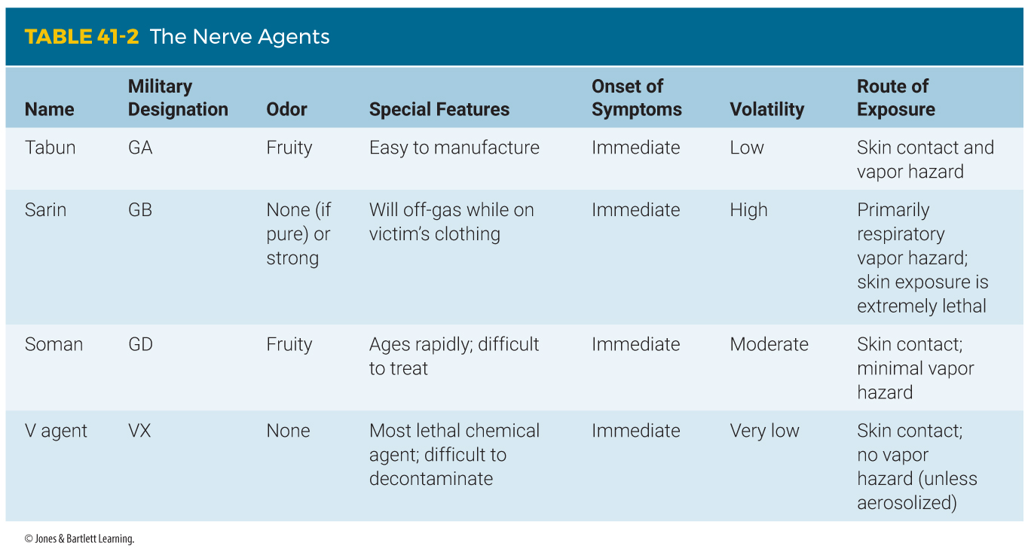
Nerve Agents (2 of 4)
Notes:
The table on this slide compares nerve agents.

Slide 41
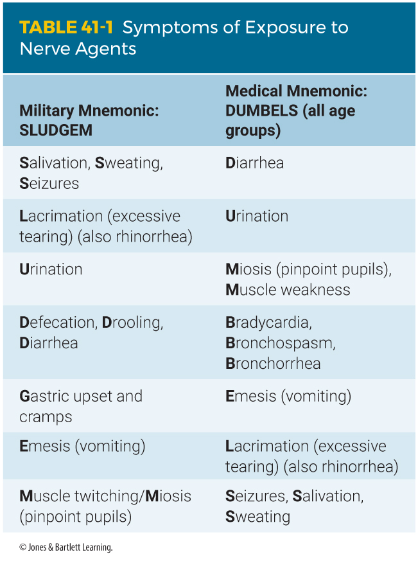
Nerve Agents (3 of 4)
Nerve agents all produce similar symptoms but have varying routes of entry.
  Use SLUDGEM and DUMBELS
Notes:
Lecture Outline
5. Nerve agents all produce similar symptoms but have varying routes of entry.
a. The symptoms are described using the military mnemonic SLUDGEM.
b. The medical mnemonic DUMBELS is also used.

Slide 42
Nerve Agents (4 of 4)
Nerve agent treatment
  DuoDote Auto-Injector (Antidote Treatment Nerve Agent Auto-Injector [ATNAA])
Notes:
Lecture Outline
Miosis is the most common symptom of nerve agent exposure and can remain for days to weeks.
a. Seen quickly in vapor exposure; may occur later after isolated skin exposure
b. The patient may have been exposed to both.
7. Seizures will continue until the patient dies or until treatment is given with an antidote kit (DuoDote Auto-Injector or Antidote Treatment Nerve Agent Auto-Injector).
8. Nerve agent treatment
a. You can greatly increase the patient’s chances of survival simply by providing airway and ventilatory support.
b. DuoDote Auto-Injector
i. Contains 2.1 mg of atropine and 600 mg of pralidoxime chloride (2-PAM)

Slide 43
Metabolic Agents (1 of 4)
Hydrogen cyanide (AC) and cyanogen chloride (CK) affect the body’s ability to use oxygen.
Commonly found in many industrial settings
Associated with dizziness, light-headedness, headache, and vomiting
Notes:
Lecture Outline
E. Metabolic agents (cyanides)
1. Hydrogen cyanide (AC) and cyanogen chloride (CK) affect the body’s ability to use oxygen.
a. Cyanide is a colorless gas with an odor similar to almonds.
2. Effects of cyanides begin on the cellular level and are very rapidly seen at the organ and system levels.
a. Commonly found in many industrial settings such as gold and silver mining, photography, and plastics processing.
b. Often present in fires associated with textile and plastic factories.
3. In low doses, these chemicals are associated with dizziness, light-headedness, headache, and vomiting.

Slide 44
Metabolic Agents (2 of 4)
High doses will produce
  Shortness of breath/gasping respirations
  Respiratory distress or arrest
  Tachypnea
  Flushed skin
  Tachycardia
Notes:
Lecture Outline
4. High doses will produce symptoms that include the following:
a. Shortness of breath and gasping respirations
b. Respiratory distress or arrest
c. Tachypnea
d. Flushed skin
e. Tachycardia

Slide 45
Metabolic Agents (3 of 4)
High doses will produce (cont’d)
  Altered mental status
  Seizures
  Coma
  Apnea
  Cardiac arrest
Notes:
Lecture Outline
f. Altered mental status
g. Seizures
h. Coma
i. Apnea
j. Cardiac arrest

Slide 46
Metabolic Agents (4 of 4)
Cyanide agent treatment
  All of the patient’s clothes must be removed to prevent off-gassing in the ambulance.
  Support the patient’s ABCs.
  Initiate transport immediately if antidote by ALS is not available.
Notes:
Lecture Outline
5. Cyanide agent treatment
a. All of the patient’s clothes must be removed to prevent off-gassing in the ambulance.
b. Decontaminate any patients who may have been exposed to liquid contamination prior to initiating treatment.
c. Support the ABCs

Slide 47
Biologic Agents (1 of 2)
Can be almost completely undetectable
Diseases caused will be similar to other minor illnesses.
May be spread in various ways
  Dissemination is the means by which a terrorist will spread the agent.
  A disease vector is an animal that spreads disease to another animal.
Notes:
Lecture Outline
VII. Biologic Agents
A. Biologic agents pose many difficult issues when used as a WMD.
1. Biologic agents can be almost completely undetectable.
2. Most of the diseases caused by these agents will be similar to other minor illnesses.
B. Biologic agents are grouped as viruses, bacteria, and neurotoxins and may be spread in various ways.
1. Dissemination is the means by which a terrorist will spread the agent.
2. A disease vector is an animal that, once infected, spreads disease to another animal.

Slide 48
Biologic Agents (2 of 2)
How easily the disease is able to spread from one human to another human is called communicability.
Incubation is the period of time between the person becoming exposed to the agent and the appearance of the first symptoms.
Notes:
Lecture Outline
3. How easily the disease is able to spread from one human to another human is called communicability.
a. In instances when communicability is high, such as with smallpox, the person is considered contagious.
4. Incubation is the period of time between the person becoming exposed to the agent and the appearance of the first symptoms.

Slide 49
Viruses (1 of 5)
Germs that require a living host to multiply and survive
Invades healthy cells and replicates itself to spread through the host
Moves from host to host by direct methods or through vectors
Notes:
Lecture Outline
C. Viruses
1. Germs that require a living host to multiply and survive.
2. Once in the body, the virus invades healthy cells and replicates itself to spread through the host.
3. Move from host to host by direct methods, such as respiratory droplets, or through vectors.
4. Some viral agents do have vaccine, however there is often no treatment for viral infection.

Slide 50
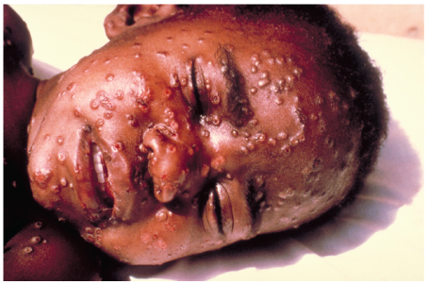
Viruses (2 of 5)
Smallpox is highly contagious.
  You must wear examination gloves, a HEPA-filtered respirator, and eye protection.
  Observe the size, shape, and location of the lesions.
FIGURE 41-11 In smallpox, all the lesions are identical in
their development. In other skin disorders, the lesions will
be in various stages of healing and development.
Courtesy of CDC.
Notes:
Lecture Outline
5. Smallpox
a. A highly contagious disease.
b. All forms of standard precautions must be used to prevent cross-contamination.
c. Wear examination gloves, a HEPA-filtered respirator, and eye protection.
d. Before the rash and blisters show, the illness will start with a high fever and body aches and headaches.
e. An easy, quick way to differentiate the smallpox rash from other skin disorders is to observe the size, shape, and location of the lesions.
i. In smallpox, all the lesions are identical in their development.
ii. Smallpox blisters begin on the face and extremities and eventually move toward the chest and abdomen.
iii. The disease is in its most contagious phase when the blisters begin to form.

Slide 51
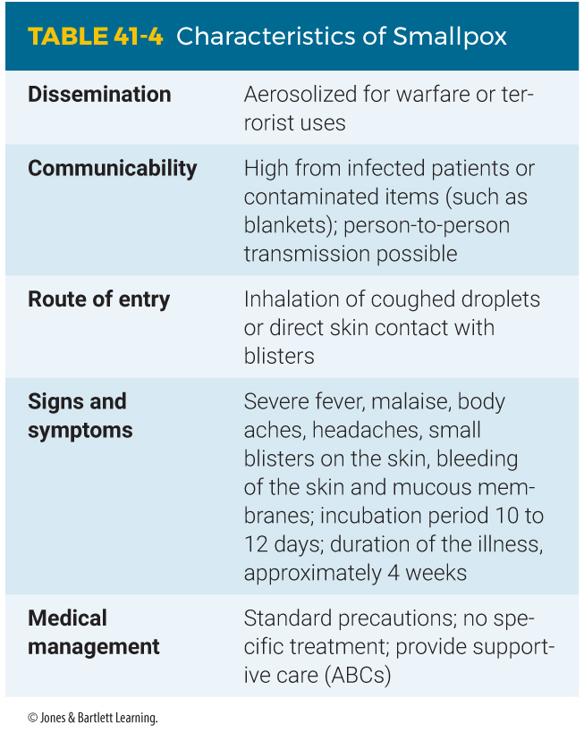
Viruses (3 of 5)
Notes:
The table on this slide lists the characteristics of smallpox.

Slide 52
Viruses (4 of 5)
Viral hemorrhagic fever (VHF)
  Causes the blood in the body to seep out from the tissues and blood vessels
  The patient will have flulike symptoms, progressing to more serious symptoms such as internal and external hemorrhaging.
  All standard precautions must be taken.
Notes:
Lecture Outline
6. Viral hemorrhagic fevers (VHFs)
a. VHFs consist of a group of diseases caused by viruses that include the Ebola, Rift Valley, Marburg, and yellow fever viruses, among others.
b. Causes the blood in the body to seep out from the tissues and blood vessels.
c. Initially, the patient will have flulike symptoms, progressing to more serious symptoms such as internal and external hemorrhaging.
d. All standard precautions must be taken when treating these illnesses.

Slide 53
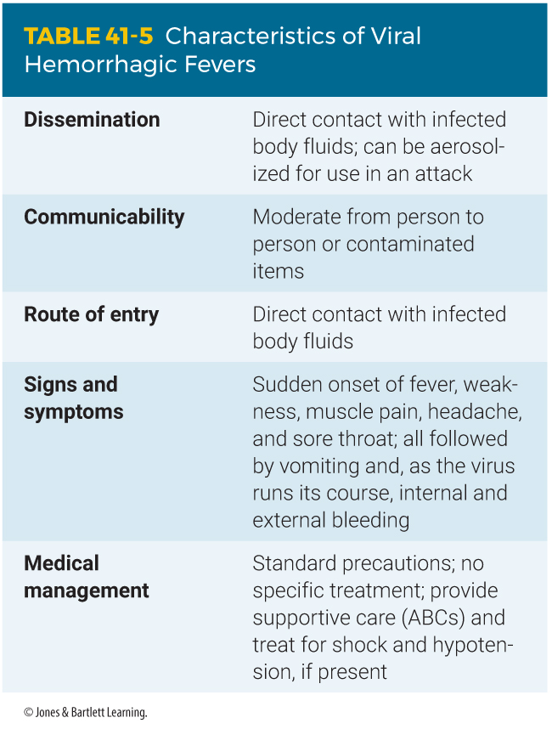
Viruses (5 of 5)
Notes:
The table on this slide lists the characteristics of viral hemorrhagic fevers.

Slide 54
Bacteria (1 of 6)
Do not require a host to multiply and live
More complex than viruses and can grow up to 100 times larger
Most can be fought with antibiotics.
Most will generally begin with flulike symptoms.
Notes:
Lecture Outline
D. Bacteria
1. Do not require a host to multiply and live.
2. Bacteria are much more complex and larger and can grow up to 100 times larger than the largest virus.
3. Most bacterial infections can be fought with antibiotics.
4. Most bacterial infections will generally begin with flulike symptoms.

Slide 55
Bacteria (2 of 6)
Inhalation and cutaneous anthrax
  Anthrax is caused by a deadly bacterium that lays dormant in a spore.
  Routes of entry are inhalation, cutaneous, and gastrointestinal.
  Pulmonary anthrax is the deadliest.
  Antibiotics can be used to treat anthrax successfully.
  A vaccine is available.
Notes:
Lecture Outline
5. Inhalation and cutaneous anthrax (Bacillus anthracis)
a. Caused by a deadly bacterium that lays dormant in a spore.
b. When exposed to the optimal temperature and moisture, the germ will be released from the spore.
c. The routes of entry are inhalation, cutaneous, and gastrointestinal.
i. The inhalation form, or pulmonary anthrax, is the deadliest and often presents as a severe cold.
ii. Pulmonary anthrax is associated with a 90% death rate if untreated.
d. Antibiotics can be used to treat anthrax successfully.
e. A vaccine is available.

Slide 56
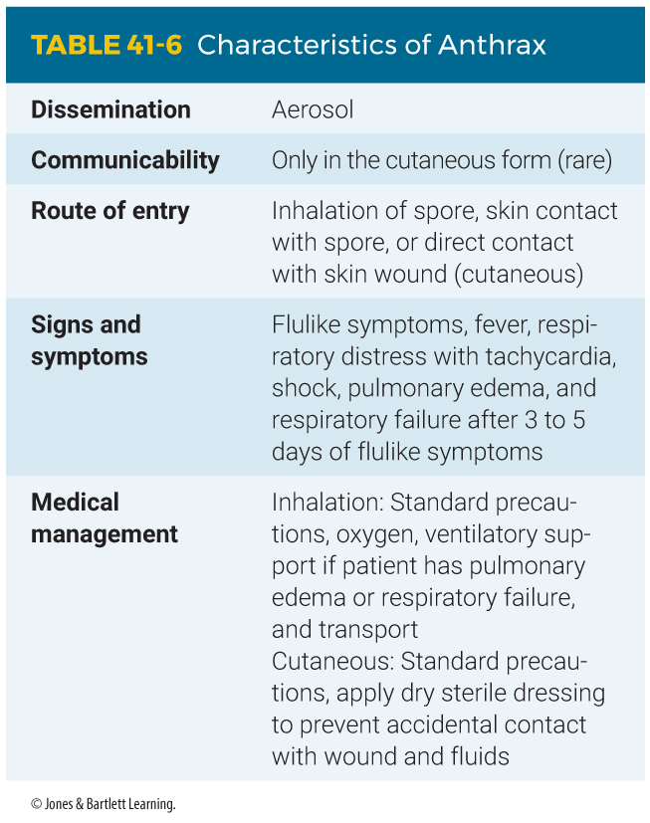
Bacteria (3 of 6)
Notes:
The table on this slide lists the characteristics of anthrax.

Slide 57
Bacteria (4 of 6)
Plague
  Natural vectors are rodents and fleas.
  Bubonic plague infects the lymphatic system and creates buboes.
  Pneumonic plague is a lung infection that results from inhalation of plague bacteria.
Notes:
Lecture Outline
6. Plague (bubonic/pneumonic)
a. The plague’s natural vectors are infected rodents and fleas.
b. Bubonic plague infects the lymphatic system.
i. The patient’s lymph nodes become infected and grow.
ii. The glands of the nodes will grow large and round, forming buboes.
iii. If left untreated, the infection may spread through the body, leading to sepsis and possibly death.
c. Pneumonic plague is a lung infection, also known as plague pneumonia, that results from inhalation of plague bacteria.
i. This form of the disease is contagious and has a much higher death rate than the bubonic form.

Slide 58
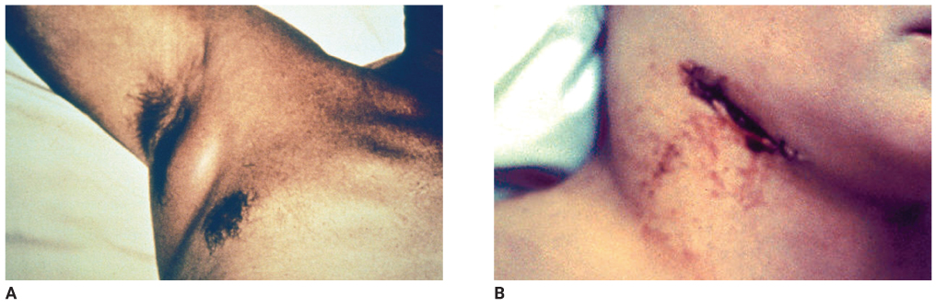
Bacteria (5 of 6)
FIGURE 41-14 A. Plague bubo at lymph node under arm. B. Plague bubo at lymph node on neck.
A, B: Courtesy of CDC.
Notes:
The figures on this slide show plague buboe. A. Plague buboe at lymph node under arm. B. Plague buboe at lymph node on neck.

Slide 59
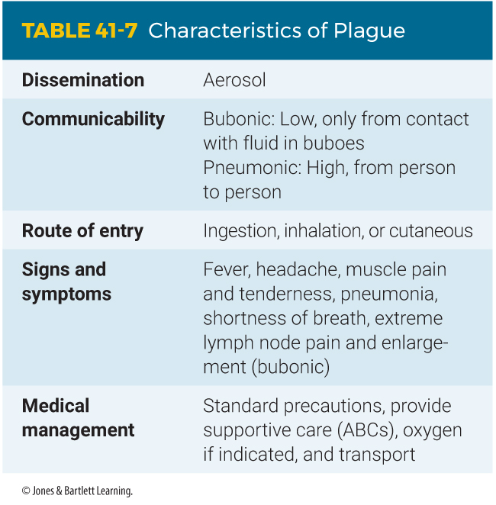
Bacteria (6 of 6)
Notes:
The table on this slide lists the characteristics of plague.

Slide 60
Neurotoxins (1 of 5)
Most deadly substances known to humans
Produced from plants, marine animals, molds, and bacteria
Route of entry is ingestion, inhalation, or injection.
Not contagious and have a faster onset of symptoms
Notes:
Lecture Outline
Neurotoxins
1. Are the deadliest substances known to humans.
2. Produced from plants, marine animals, molds, and bacteria.
3. The route of entry is through ingestion, inhalation from aerosols, or injection.
4. They are not contagious and have a faster onset of symptoms.

Slide 61
Neurotoxins (2 of 5)
Botulinum toxin
  Most potent neurotoxin
  Produced by bacteria
  Affects the nervous system’s ability to function
  Voluntary muscle control diminishes.
  Eventually the toxin causes muscle paralysis, leading to respiratory arrest.
Notes:
Lecture Outline
5. Botulinum toxin
a. The most potent neurotoxin is botulinum, which is produced by bacteria.
b. When introduced into the body, the neurotoxin affects the nervous system’s ability to function.
i. Voluntary muscle control diminishes as the toxin spreads.
ii. Eventually the toxin causes muscle paralysis, leading to respiratory arrest.

Slide 62
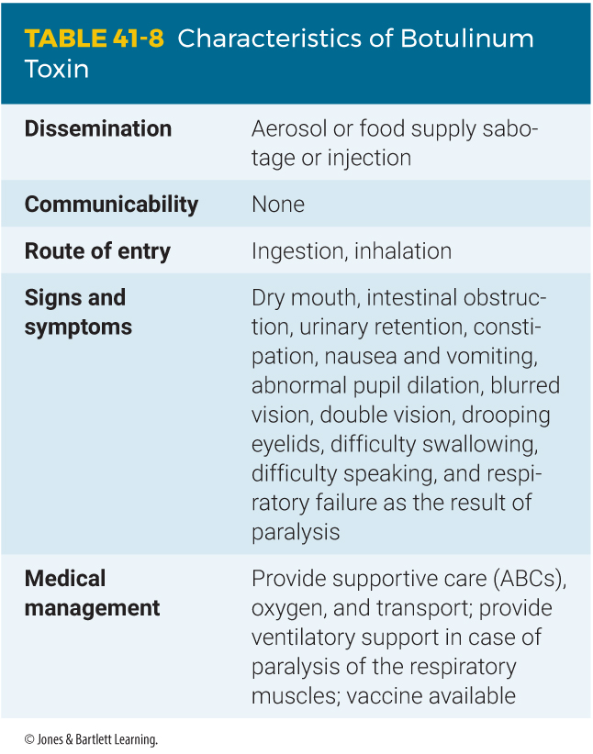
Neurotoxins (3 of 5)
Notes:
The table on this slide lists the characteristics of botulinum toxin.

Slide 63
Neurotoxins (4 of 5)
Ricin
  Derived from mash from the castor bean
  Causes pulmonary edema and respiratory and circulatory failure, leading to death
  Quite stable and extremely toxic
  Treatment is supportive and includes both respiratory support and cardiovascular support as needed.
Notes:
Lecture Outline
6. Ricin
a. Derived from mash that is left from the castor bean.
b. Causes pulmonary edema and respiratory and circulatory failure leading to death.
c. Quite stable and extremely toxic by many routes of exposure, including inhalation.
d. Signs and symptoms of ricin ingestion
i. Fever, chills, headache, muscle aches, nausea, vomiting, diarrhea, sever abdominal cramping, dehydration, gastrointestinal bleeding, necrosis of the liver, spleen, kidneys, and gastrointestinal tract.
e. Signs and symptoms of ricin inhalation
i. Fever, chills, nausea, local irritation of the eyes, nose and throat, profuse sweating, headache, muscle aches, nonproductive cough, chest pain, dyspnea, pulmonary edema, severe lung inflammation, cyanosis, seizures, and respiratory failure.
f. Treatment
i. Respiratory and cardiovascular support

Slide 64
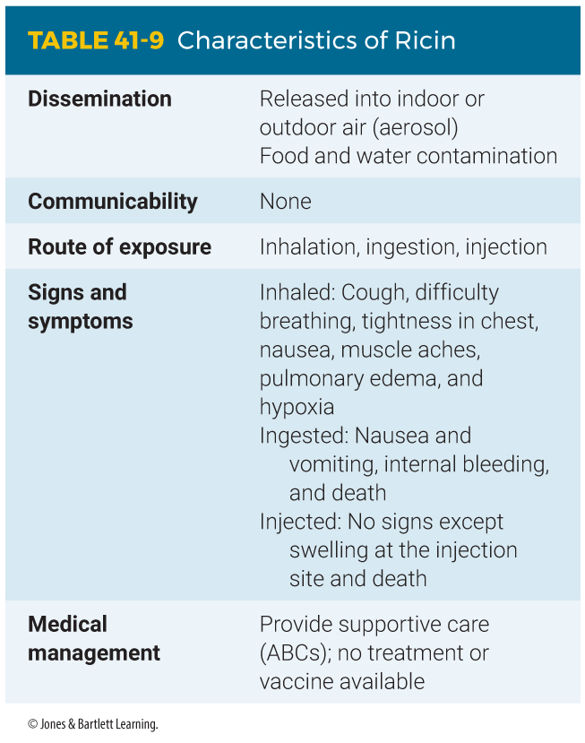
Neurotoxins (5 of 5)
Notes:
The table on this slide lists the characteristics of ricin.

Slide 65
Other EMT Roles (1 of 2)
Syndromic surveillance
  Monitoring of patients presenting to EDs and alternative care facilities
  Patients with signs and symptoms that resemble influenza are important.
  Quality assurance and dispatch need to be aware of an unusual number of calls from patients with unexplainable symptom clusters.
Notes:
Lecture Outline
F. Other EMT roles during a biologic event
1. Syndromic surveillance
a. Syndromic surveillance is the:
i. Monitoring of patients presenting to emergency departments and alternative care facilities
ii. Recording of EMS call volume
iii. Monitoring of the use of over-the-counter medications
b. Patients with signs and symptoms that resemble influenza are particularly important.
c. Quality assurance and dispatch operations need to be aware of an unusual number of calls from patients with unexplainable symptom clusters coming from a particular region or community.

Slide 66
Other EMT Roles (2 of 2)
Points of distribution (POD)
  Established in the time of need for the mass distribution of antibiotics, antidotes, vaccinations, and other medications and supplies
  Push packs distributed by the Centers for Disease Control and Prevention Strategic National Stockpile
  Push packs have a delivery time of 12 hours anywhere in the country.
Notes:
Lecture Outline
2. Points of distribution (Strategic National Stockpile)
a. PODs are existing facilities that are established in a time of need for the mass distribution of antibiotics, antidotes, vaccinations, and other medications and supplies.
b. These medications may be released in deliveries called “push packs” by the Centers for Disease Control and Prevention Strategic National Stockpile.
i. These push packages have a delivery time of 12 hours anywhere in the country.
c. EMTs, AEMTs, and paramedics may be called on to assist in the delivery of the medications to the public.
i. Your role may include triage, treatment, and transport.

Slide 67
Radiologic/Nuclear Devices (1 of 10)
Ionizing radiation is emitted in the form of rays, or particles.
Alpha, beta, gamma (x-ray), and neutron radiation
  Alpha is the least harmful type.
  Beta is slightly more penetrating.
  Gamma rays are faster and stronger.
  Neutron particles are the most powerful.
Notes:
Lecture Outline
VIII. Radiologic/Nuclear Devices
A. What is radiation?
1. Ionizing radiation is emitted in the form of rays, or particles.
2. This energy can be found in radioactive material, such as rocks and metals.
a. Radioactive material is any material that emits radiation.
b. This material is unstable, and it attempts to stabilize itself by changing its structure in a natural process called decay.
3. The energy that is emitted from a strong radiologic source is alpha, beta, gamma (x-ray), or neutron radiation.
a. Alpha is the least harmful penetrating type and cannot move through most objects.
b. Beta radiation is slightly more penetrating than alpha and requires a layer of clothing to stop it.
c. Gamma rays are far faster and stronger than alpha and beta rays.
i. These rays easily penetrate through the human body and require lead or several inches of concrete to prevent penetration.
d. Neutron particles are among the most powerful forms of radiation.
i. Neutrons easily penetrate through lead and require several feet of concrete to stop them.

Slide 68
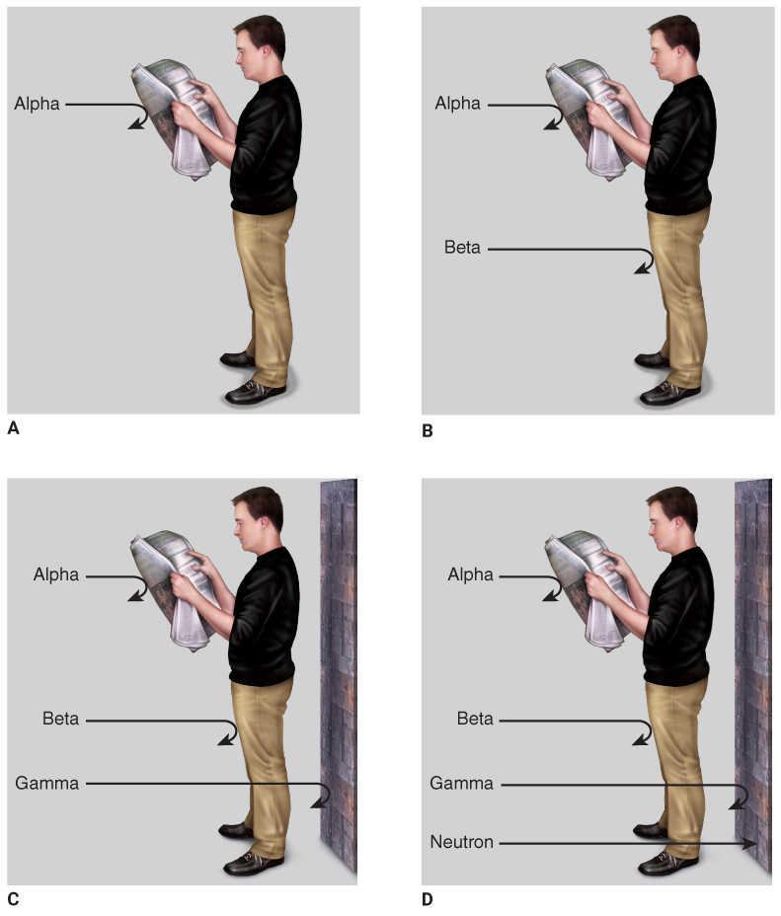
Radiologic/Nuclear Devices (2 of 10)
FIGURE 41-17 The penetrating potential of radiation. A. Alpha. B. Beta. C. Gamma. D. Neutron.
A-D: © Jones & Bartlett Learning.
Notes:
The figures on this slide show what can deflect the four types of radiation. A. Alpha. B. Beta. C. Gamma. D. Neutron.

Slide 69
Radiologic/Nuclear Devices (3 of 10)
Once radiologic material has been used, the remaining material is called radiologic waste.
These materials can be found at:
  Hospitals and health care facilities with radiology departments
  Colleges and universities
  Nuclear power plants
  Chemical and industrial sites
Notes:
Lecture Outline
B. Sources of radiologic material
1. Radiologic materials are generally used for purposes that benefit humankind, such as:
a. Medicine
b. Killing germs in food (irradiating)
c. Construction
2. Once radiologic material has been used for its purpose, the material remaining is called radiologic waste; these materials can be found at:
a. Hospitals and health care facilities with radiology departments
b. Colleges and universities
c. Nuclear power plants
d. Chemical and industrial sites

Slide 70
Radiologic/Nuclear Devices (4 of 10)
Radiologic dispersal devices (RDDs)
  Any container designed to disperse radioactive material
  A “dirty bomb” can injure victims with the radioactive or explosive material.
  The dirty bomb is an ineffective WMD.
Notes:
Lecture Outline
C. Radiologic dispersal devices (RDDs)
1. Any container that is designed to disperse radioactive material.
2. A dirty bomb carries the potential to injure victims with not only the radioactive material, but also the explosive material used to deliver it.
3. The destructive capability of a dirty bomb is limited to the explosives that are attached to it.
4. The dirty bomb is an ineffective WMD.

Slide 71
Radiologic/Nuclear Devices (5 of 10)
Nuclear energy is artificially made by altering (splitting) radioactive atoms.
  The result is an immense amount of energy that usually takes the form of heat.
  Nuclear material is used in:
    Medicine
    Weapons
    Naval vessels
    Power plants
Notes:
Lecture Outline
D. Nuclear energy
1. Artificially made by altering (splitting) radioactive atoms.
2. The result is an immense amount of energy that usually takes the form of heat.
3. Nuclear material is used in:
a. Medicine
b. Weapons
c. Naval vessels
d. Power plants
4. Nuclear material gives off all forms of radiation, including neutrons.

Slide 72
Radiologic/Nuclear Devices (6 of 10)
Nuclear weapons
  Kept only in secure facilities
  The likelihood of a nuclear attack is extremely remote.
  The whereabouts of many small nuclear devices are unknown.
    Special Atomic Demolition Munition (SADM)
Notes:
Lecture Outline
E. Nuclear weapons
1. Kept only in secure facilities throughout the world.
2. The likelihood of a nuclear attack is extremely remote.
3. Since the collapse of the former Soviet Union, the whereabouts of many small nuclear devices are unknown.
a. These small suitcase-sized nuclear weapons are called Special Atomic Demolition Munitions (SADMs).
b. Some of these are believed to be missing.

Slide 73
Radiologic/Nuclear Devices (7 of 10)
Patients exposed to excessive radiation are considered victims of acute radiation toxicity.
Effects of radiation exposure will vary depending on the amount of radiation and the route of entry.
  Radiation can be introduced into the body by all routes of entry.
Notes:
Lecture Outline
F. Symptomatology
1. Patients exposed to a known or suspected source of excessive radiation are considered victims of acute radiation toxicity.
2. The effects of radiation exposure will vary depending on the amount of radiation that a person receives and the route of entry.
3. Radiation can be introduced into the body by all routes of entry as well as through the body (irradiation).

Slide 74
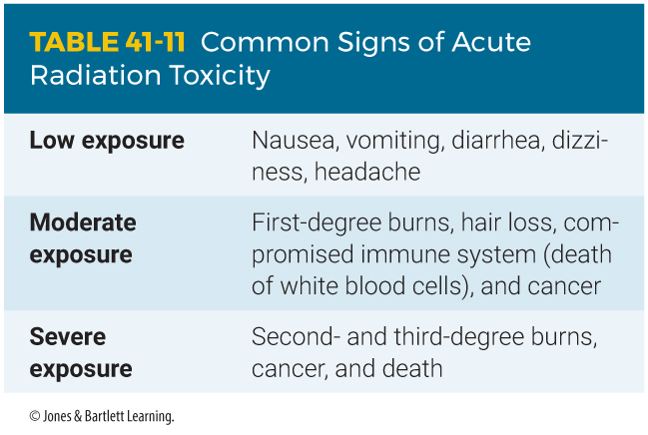
Radiologic/Nuclear Devices (8 of 10)
Notes:
The table on this slide lists the common signs of acute radiation toxicity.

Slide 75
Radiologic/Nuclear Devices (9 of 10)
Being exposed to a radiation source does not make a patient contaminated or radioactive.
  However, when patients have a radioactive source on their body, they must be initially cared for by a hazmat responder.
  After decontamination, you may begin treatment with the ABCs.
  Wear appropriate PPE, and place all body fluids in containers for proper disposal.
Notes:
Lecture Outline
G. Medical management
1. Being exposed to a radiation source does not make a patient contaminated or radioactive.
2. However, when patients have a radioactive source on their body, they are contaminated and must be initially cared for by a hazmat responder.
3. Once the patient is decontaminated, you may begin treatment with the ABCs and treat the patient for any burns or trauma.
4. Wear appropriate PPE.
a. Secure in plastic bags any bodily fluids obtained from the patient.
b. Place all body fluids in containers and properly dispose of them with other potentially radioactive waste.

Slide 76
Radiologic/Nuclear Devices (10 of 10)
There is no protective gear designed to completely shield you from radiation.
  The less time that you are exposed to the source, the less the effects will be.
  Make certain that responders are stationed far enough from the incident.
  Always assume it is the strongest form of radiation and use concrete shielding.
Notes:
Lecture Outline
H. Protective measures
1. There are no suits or protective gear designed to completely shield you from radiation.
2. The best ways to protect yourself from the effects of radiation:
a. Time
b. Distance
c. Shielding

Slide 77
Incendiary and Explosive Devices (1 of 6)
Incendiary (used to start fires) and explosive devices come in various shapes and sizes.
  It is important to identify an object you believe is a potential device.
  Notify the authorities, and safely evacuate the area.
Always remember that there is the possibility of a secondary device when you respond to the scene.
Notes:
Lecture Outline
IX. Incendiary and Explosive Devices
A. Incendiary and explosive devices come in various shapes and sizes.
1. Incendiary devices are weapons used to start fires; terrorists use
a. Flamethrowers
b. Chemicals
c. Molotov cocktails
d. Other explosive devices
2. It is important for you to be able to identify an object you believe is a potential device, notify the proper authorities, and safely evacuate the area.
3. Remember that there is the possibility of a secondary device when you are responding to the scene.

Slide 78
Incendiary and Explosive Devices (2 of 6)
Primary blast injury
  Direct effects of the pressure wave on the body
  Seen almost exclusively in the hollow organs
  An injury to the lungs causes the greatest morbidity and mortality.
Secondary blast injury
  Penetrating or nonpenetrating injury that results from flying debris
Notes:
Lecture Outline
B. Mechanisms of injury
1. The type and severity of wounds primarily depend on the patient’s distance from the epicenter of the explosion.
2. Blast injuries occur in a number of ways.
a. Primary blast injury
i. Due solely to the direct effects of the pressure wave on the body
ii. The injury is seen almost exclusively in the hollow organs of the body.
iii. An injury to the lungs causes the greatest morbidity and mortality.
b. Secondary blast injury
i. Penetrating or nonpenetrating injury that results from being struck by flying debris
ii. Objects are propelled by the force of the blast and strike the victim, causing injury.

Slide 79
Incendiary and Explosive Devices (3 of 6)
Tertiary blast injury
  Whole body displacement and subsequent impact with environmental objects
  Also includes crush injury
Quaternary blast injury
  Any other injury caused by a blast
Notes:
Lecture Outline
c. Tertiary blast injury
i. Results from whole body displacement and subsequent traumatic impact with environmental object
ii. Other indirect effects include crush injury from the collapse of structures.
d. Quaternary blast injury
i. Any other injury caused by a blast, including toxic inhalation of combustion gases, burns, a medical emergency (like a myocardial infarction) sustained while fleeing the scene of an explosion, and even a mental health disorder that develops immediately after or days to weeks after detonation of an explosive device.

Slide 80
Incendiary and Explosive Devices (4 of 6)
The physics of an explosion
  When a substance is detonated, a solid or liquid is chemically converted into gas under high pressure.
  This generates a spherical blast wave.
  Flying debris and high winds commonly cause conventional blunt and penetrating trauma.
Notes:
Lecture Outline
3. The physics of an explosion
a. When a substance is detonated, a solid or liquid is chemically converted into large volumes of gas under high pressure with resultant explosive energy release.
b. This generates a pressure pulse in the shape of a spherical blast wave that expands in all directions from the point of explosion.
c. Flying debris and high winds commonly cause conventional blunt and penetrating trauma.

Slide 81
Incendiary and Explosive Devices (5 of 6)
Hollow organs such as the middle ear, lung, and GI tract are most susceptible to pressure changes.
  The ear is the organ system most sensitive to blast injuries.
  Primary pulmonary blast injuries occur as contusions and hemorrhages.
Notes:
Lecture Outline
4. Tissues at risk
a. Hollow organs such as the middle ear, lungs, and GI tract are most susceptible to pressure changes.
b. The junction between tissues of different densities and exposed tissues such as the head and neck are prone to injury as well.
c. The ear is the organ system most sensitive to blast injuries.
i. The patient may report ringing or pain in the ears or some loss of hearing, and blood may be visible in the ear canal.
d. Primary pulmonary blast injuries occur as contusions and hemorrhages.
i. Patients may report tightness or pain in the chest and may cough up blood and have tachypnea or other signs of respiratory distress.
ii. Subcutaneous emphysema over the chest may be palpated, indicating the presence of a pneumothorax.
iii. Pneumothorax is common and may require emergency decompression.
e. Solid organs are relatively protected from shockwave injury but may be injured by secondary missiles or a hurled body.
f. Hollow organs may be injured by similar mechanisms as lung tissue.
i. Petechiae to large hematomas are the most visible sign.

Slide 82
Incendiary and Explosive Devices (6 of 6)
Blast lung is the most common cause of death from blast injury.
Neurologic injuries and head trauma are also common causes of death from blast injuries.
Extremity injuries, including traumatic amputations, are common.
Notes:
Lecture Outline
g. According to the CDC, blast lung is the most common cause of death from blast injury.
h. Neurologic injuries and head trauma are also common causes of fatality from blast injury.
i. Subarachnoid and subdural hematomas are often seen.
ii. Permanent or transient neurologic deficits may be secondary to concussion, intracerebral bleeding, or air embolism.
iii. Instant but transient unconsciousness, with or without retrograde amnesia, may be initiated.
iv. Bradycardia and hypotension are common after an intense pressure wave from an explosion.
i. Extremity injuries, including traumatic amputations, are common, and patients may die of massive hemorrhage without the rapid application of a tourniquet.

Slide 83
Review
What type of terrorist group would MOST likely bomb an abortion clinic?
  Single-issue group
  Technology terrorists
  Extremist political group
  Violent religious group

Slide 84
Review
Answer: A
Rationale: Single-issue terrorist groups, as their name implies, focus on single issues. They include antiabortion groups, animal rights groups, anarchists, racists, or even ecoterrorists, who threaten violence as a means to protect the environment.

Slide 85
Review
What type of terrorist group would MOST likely bomb an abortion clinic?
  Single-issue group
  Rationale: Correct answer
  Technology terrorists
  Rationale: Technology terrorists would attack the technology infrastructure.
  Extremist political group
  Rationale: An extremist political group seeks political, religious, economic, and social freedom.
  Violent religious group
  Rationale: Violent religious groups, also known as doomsday cults, may participate in apocalyptic violence.

Slide 86
Review
The term “weaponization” is defined as:
  the period of time that a chemical agent will remain on a given surface before it evaporates.
  the method or mechanism by which a terrorist or terrorist group delivers a chemical or biologic agent.
  the cultivation, synthetization, and/or mutation of an agent in order to maximize the target population’s exposure.
  the detonation of an explosive device utilizing an item that is inconspicuous, such as a briefcase or suitcase.

Slide 87
Review
Answer: C
Rationale: Weaponization is the creation of a weapon from a biologic agent generally found in nature that causes disease. The agent is cultivated, synthesized, and/or mutated to maximize the target population’s exposure to the agent.

Slide 88
Review
The term “weaponization” is defined as:
  the period of time that a chemical agent will remain on a given surface before it evaporates.
  Rationale: This is persistency and volatility.
  the method or mechanism by which a terrorist or terrorist group delivers a chemical or biologic agent.
  Rationale: This is dissemination.
  the cultivation, synthetization, and/or mutation of an agent in order to maximize the target population’s exposure.
  Rationale: Correct answer
  the detonation of an explosive device utilizing an item that is inconspicuous, such as a briefcase or suitcase.
  Rationale: This is not the correct answer.

Slide 89
Review
The Department of Homeland Security posts a daily advisory system to keep the public aware of the current terrorist threat level. What does an orange level indicate?
  Low: Low risk of terrorist attacks
  High: High risk of terrorist attacks
  Severe: Severe risk of terrorist attacks
  Elevated: Significant risk of terrorist attacks

Slide 90
Review
Answer: B
Rationale: According to the Department of Homeland Security (DHS) advisory system, the color orange indicates a high risk of terrorist attacks. Red, the highest level, indicates a severe risk of terrorist attacks. Yellow (elevated) indicates a significant risk of terrorist attacks. Blue (guarded) indicates a general risk of terrorist attacks. Green indicates a low risk of terrorist attacks.

Slide 91
Review
The Department of Homeland Security posts a daily advisory system to keep the public aware of the current terrorist threat level. What does an orange level indicate?
  Low: Low risk of terrorist attacks
  Rationale: This is a green level.
  High: High risk of terrorist attacks
  Rationale: Correct answer
  Severe: Severe risk of terrorist attacks
  Rationale: This is a red level.
  Elevated: Significant risk of terrorist attacks
  Rationale: This is a yellow level.

Slide 92
Review
You are dispatched to a bombing along with 15 other ambulances. Upon arriving at the scene, you should stage your ambulance:
  as close to the bombing site as possible.
  upwind and uphill from the bombing site.
  downwind and uphill from the bombing site.
  upwind and downhill from the bombing site.

Slide 93
Review
Answer: B
Rationale: As with any hazmat incident, you should stage your ambulance uphill and upwind from a bombing site. A hazardous chemical may have been released during the bombing; remaining uphill and upwind from the incident site will minimize your risk of exposure.

Slide 94
Review
You are dispatched to a bombing along with 15 other ambulances. Upon arriving at the scene, you should stage your ambulance:
  as close to the bombing site as possible.
  Rationale: You do not know if there was a chemical release or if there may be additional bombings.
  upwind and uphill from the bombing site.
  Rationale: Correct answer
  downwind and uphill from the bombing site.
  Rationale: You should treat the scene like a hazmat situation; stay upwind.
  upwind and downhill from the bombing site.
  Rationale: You should remain uphill.

Slide 95
Review
A terrorist would MOST likely use a secondary explosive device:
  to ensure that a structure is completely destroyed.
  in case the primary explosive device fails to detonate.
  as a means of dispersing a biologic or chemical agent.
  to injure rescuers and gain maximum public attention.

Slide 96
Review
Answer: D
Rationale: A secondary explosive device is usually aimed at injuring or killing rescue workers. It is also designed to be caught on camera by the media, which draws public attention to the terrorist. Biologic or chemical agents can be dispersed by the primary device, the secondary device, or both.

Slide 97
Review
A terrorist would MOST likely use a secondary explosive device:
  to ensure that a structure is completely destroyed.
  Rationale: The building will be destroyed by the first explosive device if that is the intention of the terrorist.
  in case the primary explosive device fails to detonate.
  Rationale: A secondary explosive device is not usually needed for this reason.
  as a means of dispersing a biologic or chemical agent.
  Rationale: These agents can be dispersed in either a primary or secondary device.
  to injure rescuers and gain maximum public attention.
  Rationale: Correct answer

Slide 98
Review
When assessing a patient who was exposed to a vesicant agent, you should expect to encounter:
  skin blistering.
  loss of hearing.
  vomiting blood.
  profound bradycardia.

Slide 99
Review
Answer: A
Rationale: The primary exposure route of vesicant agents—also called blister agents—is the skin. Vesicants usually cause the most damage to damp or moist areas of the body, such as the armpits, groin, and respiratory tract. Signs of vesicant exposure on the skin include irritation, reddening, and burning; immediate, intense pain; and the formation of large blisters, among others.

Slide 100
Review
When assessing a patient who was exposed to a vesicant agent, you should expect to encounter:
  skin blistering.
  Rationale: Correct answer
  loss of hearing.
  Rationale: A vesicant agent will cause blindness.
  vomiting blood.
  Rationale: A vesicant agent will cause the patient to cough up blood.
  profound bradycardia.
  Rationale: This is incorrect.

Slide 101
Review
What does sulfur mustard do to the cells within the body?
  It makes the cells retain water until they explode.
  It causes the cells to release all their energy, which then causes cellular death.
  It makes the cells mutate, which damages and changes the cells and causes cellular death.
  It makes the cells release all their fluids and causes severe dehydration until cellular death occurs.

Slide 102
Review
Answer: C
Rationale: Sulfur mustard (agent H) causes the cells to mutate, which changes the structure of the cell so it can no longer perform its functions within the body. This causes cellular death, which can lead to end organ failure.

Slide 103
Review
What does sulfur mustard do to the cells within the body?
  It makes the cells retain water until they explode.
  Rationale: Sulfur mustard makes cells mutate.
  It causes the cells to release all their energy, which then causes cellular death.
  Rationale: Cellular death occurs due to mutation.
  It makes the cells mutate, which damages and changes the cells and causes cellular death.
  Rationale: Correct answer
  It makes the cells release all their fluids and causes severe dehydration until cellular death occurs.
  Rationale: This is incorrect.

Slide 104
Review
Pinpoint pupils, vomiting, bradycardia, and excessive salivation are signs of exposure to:
  lewisite.
  soman.
  cyanide.
  phosgene.

Slide 105
Review
Answer: B
Rationale: Soman (GD) is a nerve agent; it can cause death within seconds to minutes of exposure. The mnemonic “DUMBELS” can help you recall the signs and symptoms of nerve agent exposure. It stands for Diarrhea; Urination; Miosis (pinpoint pupils); Bradycardia and bronchospasm; Emesis (vomiting); Lacrimation (excessive tearing); and Salivation, seizures, and sweating.

Slide 106
Review
Pinpoint pupils, vomiting, bradycardia, and excessive salivation are signs of exposure to:
  lewisite.
  Rationale: Lewisite produces blister wounds similar to mustard gas.
  soman.
  Rationale: Correct answer
  cyanide.
  Rationale: Cyanide causes tachycardia, tachypnea, and flushed skin.
  phosgene.
  Rationale: Phosgene causes nausea, chest tightness, severe cough, and dyspnea upon exertion.

Slide 107
Review
You respond to a plastic factory, where numerous people present with shortness of breath, flushed skin, and altered mental status. One of the patients tells you he smelled almonds before he started feeling sick. These people were MOST likely exposed to:
  sarin.
  bleach.
  cyanide.
  chlorine.

Slide 108
Review
Answer: C
Rationale: Cyanide is a colorless gas that has the odor of almonds. It is produced in many different industries in the United States such as plastic processing, gold and silver mines, and photography studios. You should suspect a chemical exposure whenever multiple patients present with the same or similar symptoms.

Slide 109
Review
You respond to a plastic factory, where numerous people present with shortness of breath, flushed skin, and altered mental status. One of the patients tells you he smelled almonds before he started feeling sick. These people were MOST likely exposed to:
  sarin.
  Rationale: Sarin is colorless and odorless.
  bleach.
  Rationale: Bleach will not smell like almonds.
  cyanide.
  Rationale: Correct answer
  chlorine.
  Rationale: Chlorine has a distinct odor of bleach.

Slide 110
Review
Factors that have the GREATEST impact on the severity of radiation exposure include:
  age and overall health.
  gender and wind speed.
  the method of dispersal.
  time, distance, and shielding.

Slide 111
Review
Answer: D
Rationale: The best way to protect yourself from the effects of radiation is to use time, distance, and shielding. Radiation has a cumulative effect; the less time you are exposed, the less the effects will be. Radiation is also limited in how far it can travel; depending on the type of radiation, moving only a few feet may be enough to remove you from immediate danger. The path of all radiation can be stopped by a specific object; alpha rays can be stopped by a newspaper, beta rays by your clothing, and gamma rays by several feet of concrete.

Slide 112
Review
Factors that have the GREATEST impact on the severity of radiation exposure include:
  age and overall health.
  Rationale: Radiation can affect anyone, regardless of age.
  gender and wind speed.
  Rationale: Males and females will experience the same effects.
  the method of dispersal.
  Rationale: The type of radiation—alpha, beta, or gamma—has the greatest impact on the human body.
  time, distance, and shielding.
  Rationale: Correct answer

